Slide 1
Spatiotemporal Analysis of Urban Noise Data
Prof – Fabio Miranda
- By
Sasanka Mouli Veleti
Ashwin Srivatsa
Siddharth Veluvolu

Slide 2
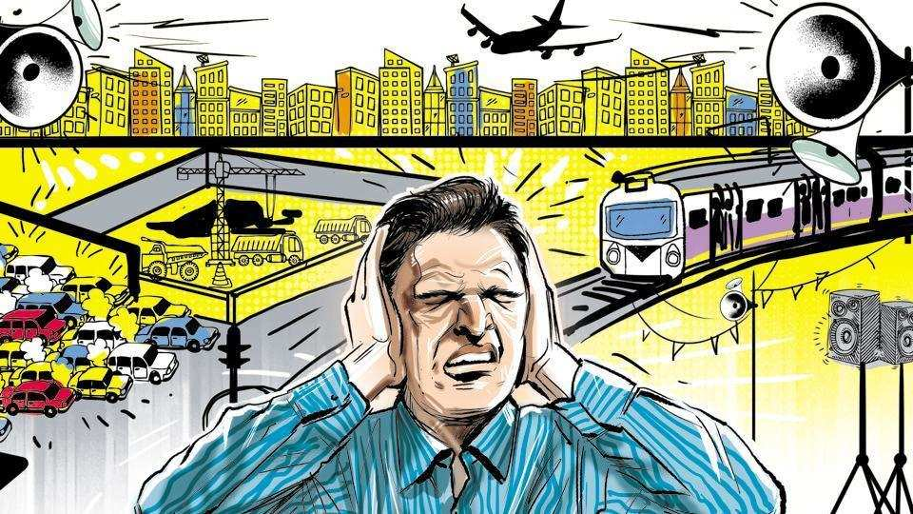
Introduction :
Noise Pollution is a grievous problem which needs to be tackled, as it’s a growing concern for many urban residents.
Noise is not only inconvenient and annoying, but it has also been proven to be a health hazard, many have reported that they suffered with behavioral and emotional consequences, such as difficulty in sleeping, relaxing and feeling annoyed, angry or upset.
Sound event detection is a popular technique to identify the sound events in the noise e.g., “dog barking, engine exhaust noise” etc.

Slide 3
Related works:
Mark Cartwright, Ana Elisa, Mendez Mendez1 and J. P. Bello. Sonyc urban sound tagging (sonycust): A multilabel dataset from an urban acoustic sensor network. Detection and Classification of Acoustic Scenes and Events 201, October 2019.
SONYC has developed an acoustic sensor with high quality and low production cost to monitor the noise pollution levels across the city in neighborhoods like Manhattan, Brooklyn and Queens.
The VGG models were trained on this data and the AUPRC achieved by the models are 0.62 and 0.76 which performed poorly on music and non-machinery sounds.

Slide 4
Data Description:
In order to build a system which would visualize the various sound points in and around a particular geographical location and also allow us to analyze the mismatches between the test and machine data, we need to have a dataset which has a diverse distribution of labeled sounds with spatial and temporal attributes.
For which we have taken a dataset containing a training subset (13538 recordings from 35 sensors), validation subset (4308 recordings from 9 sensors), and a test subset (669 recordings from 48 sensors).
Each recording has been annotated using a set of 23 “sound tags” like “engine presence, machinery presence, non-machinery-impact presence, dog-barking-whining presence, music presence etc.”
The audio was recorded from the SONYC(SONYC Urban Sound Tagging) acoustic sensor network.

Slide 5
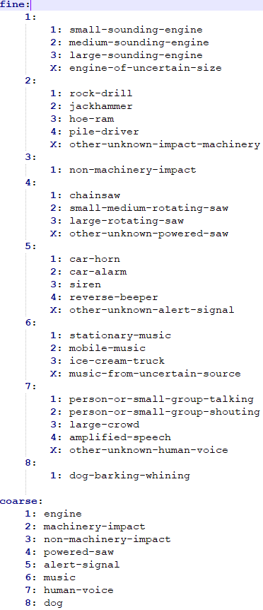
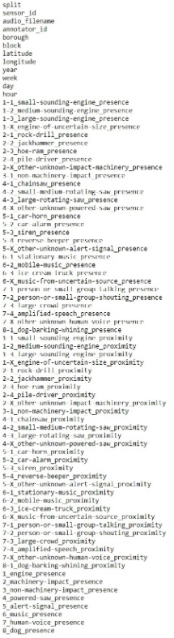
The images explains the taxonomy of sounds to classify in the dataset.

Slide 6
Proposal:
We propose to build a tool which visualizes the spatiotemporal and mismatch values of the dataset.
Using Multi Label Classification Machine Learning Algorithms we will classify the audio files into various categorical sounds.
Visualize the points where the mismatches of testing and machine predicted data occur based on the results of the Machine Learning model.
We will dwell into understanding the mismatches which occur between the annotated and machine predicted data and analyze the causes behind it.

Slide 7
Implementation:
Extracting embeddings from the audio files using OpenL3.
Train the fine-level model and produce predictions
Evaluate the fine-level model output file (using frame-averaged clip predictions) on AUPRC
Evaluate the coarse-level model output file (using frame-averaged clip predictions) on AUPRC
Analysis of mismatches between the predicted and truth values
Build a system to visualize the results
Train the coarse-level model and produce predictions

Slide 8
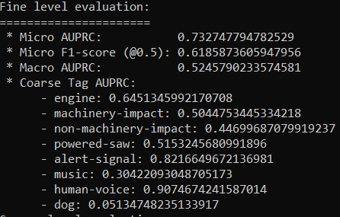
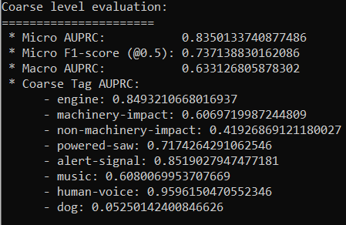
Evaluations of the Model:
The model on fine level data performed with a F1-score 61% accuracy.
The model on coarse level data performed with a F1-score 73% accuracy.

Slide 9
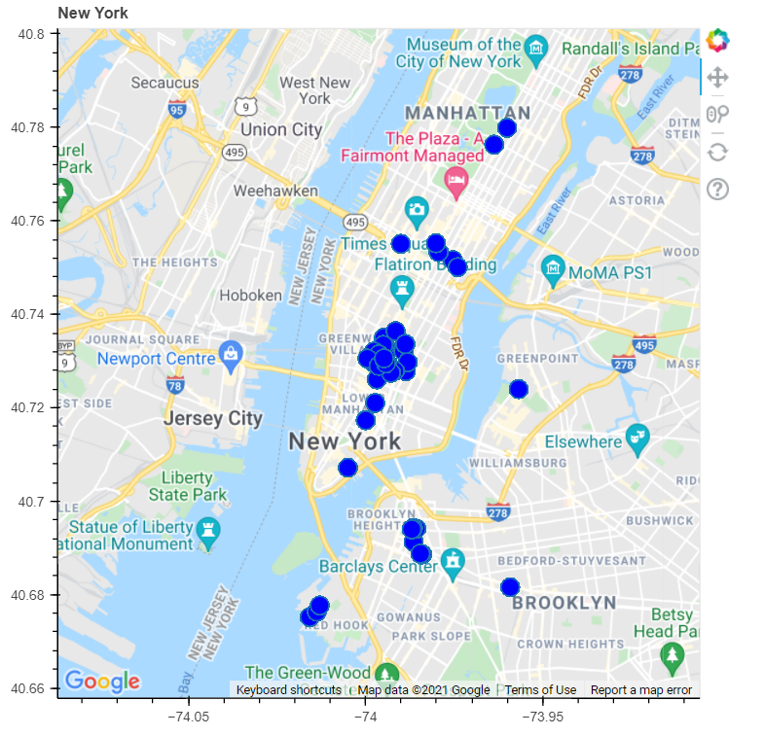
Analysis of Model outputs
The points where sensors are placed are plotted on the map.

Slide 10
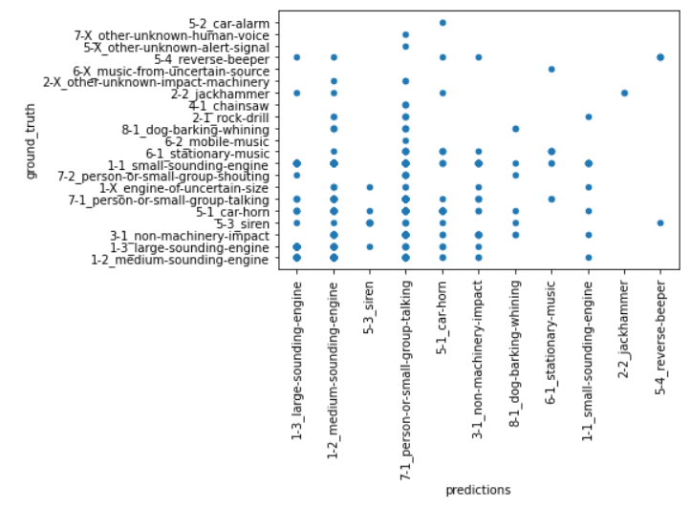
Scatter plot for predictions vs ground truth

Slide 11
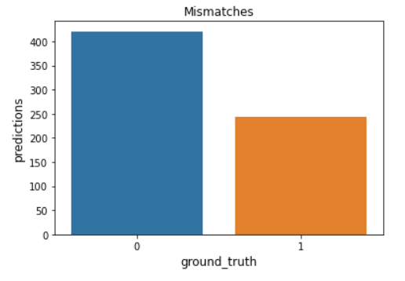
The mismatches are about 421 and matches are 243.

Slide 12
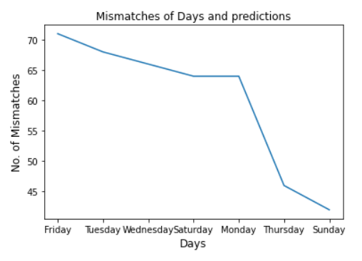
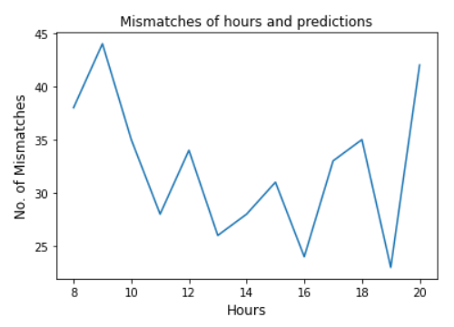

Slide 13
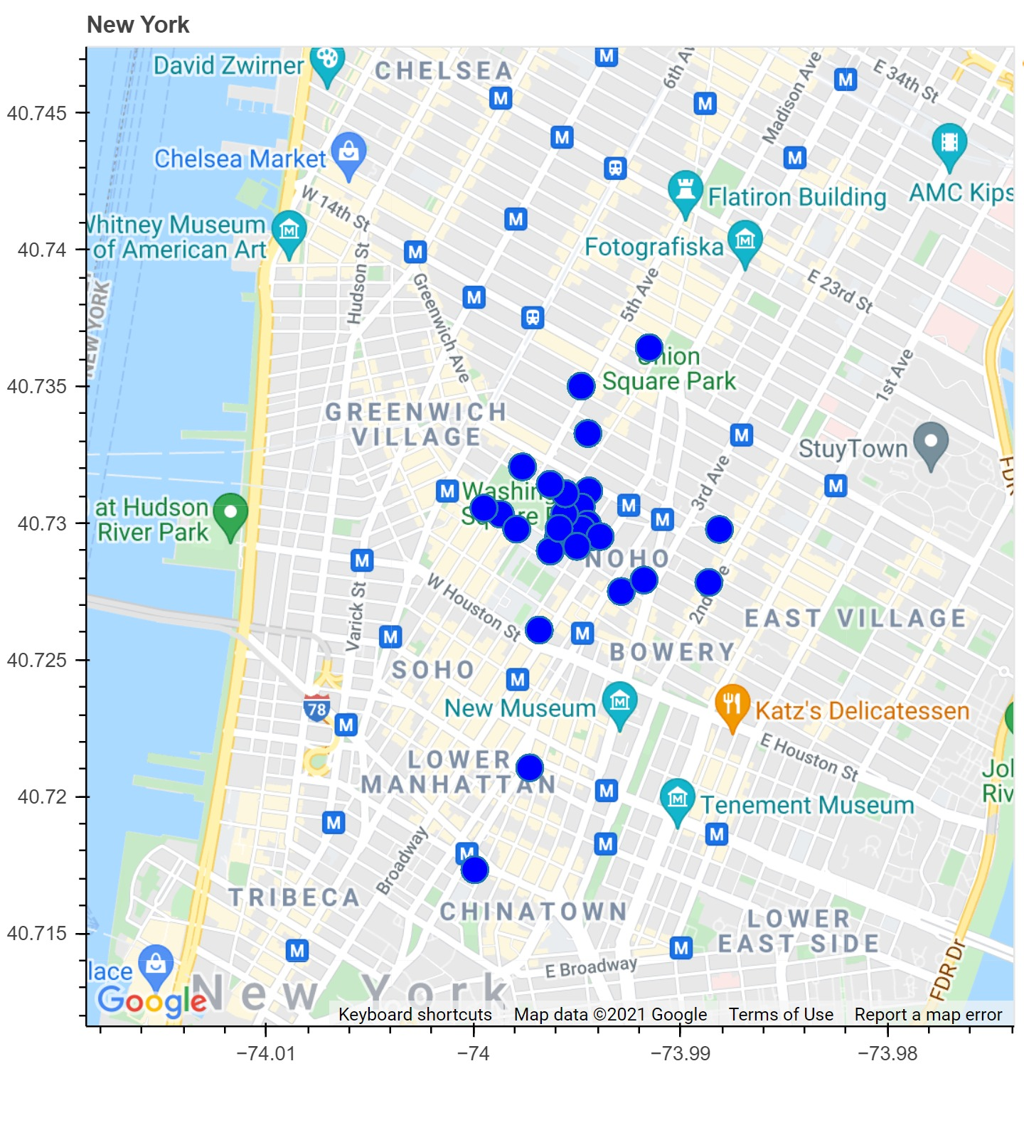
The map shows sensors from which we got mismatches

